Slide 1



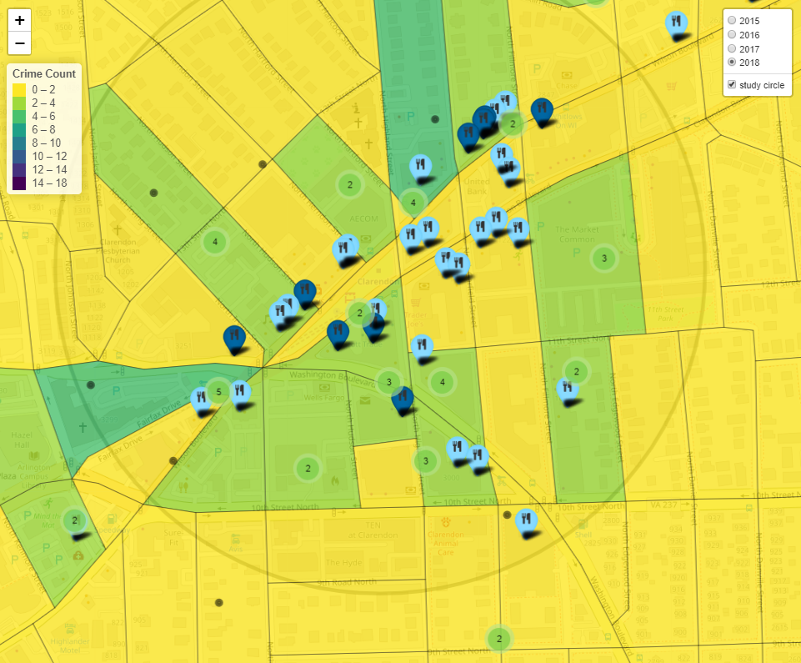
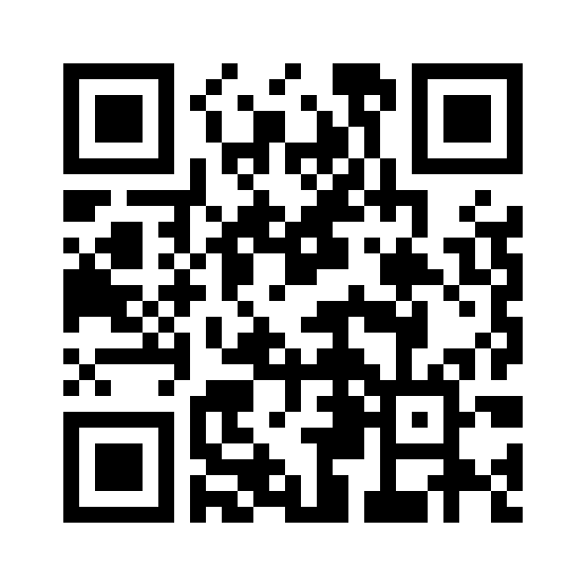
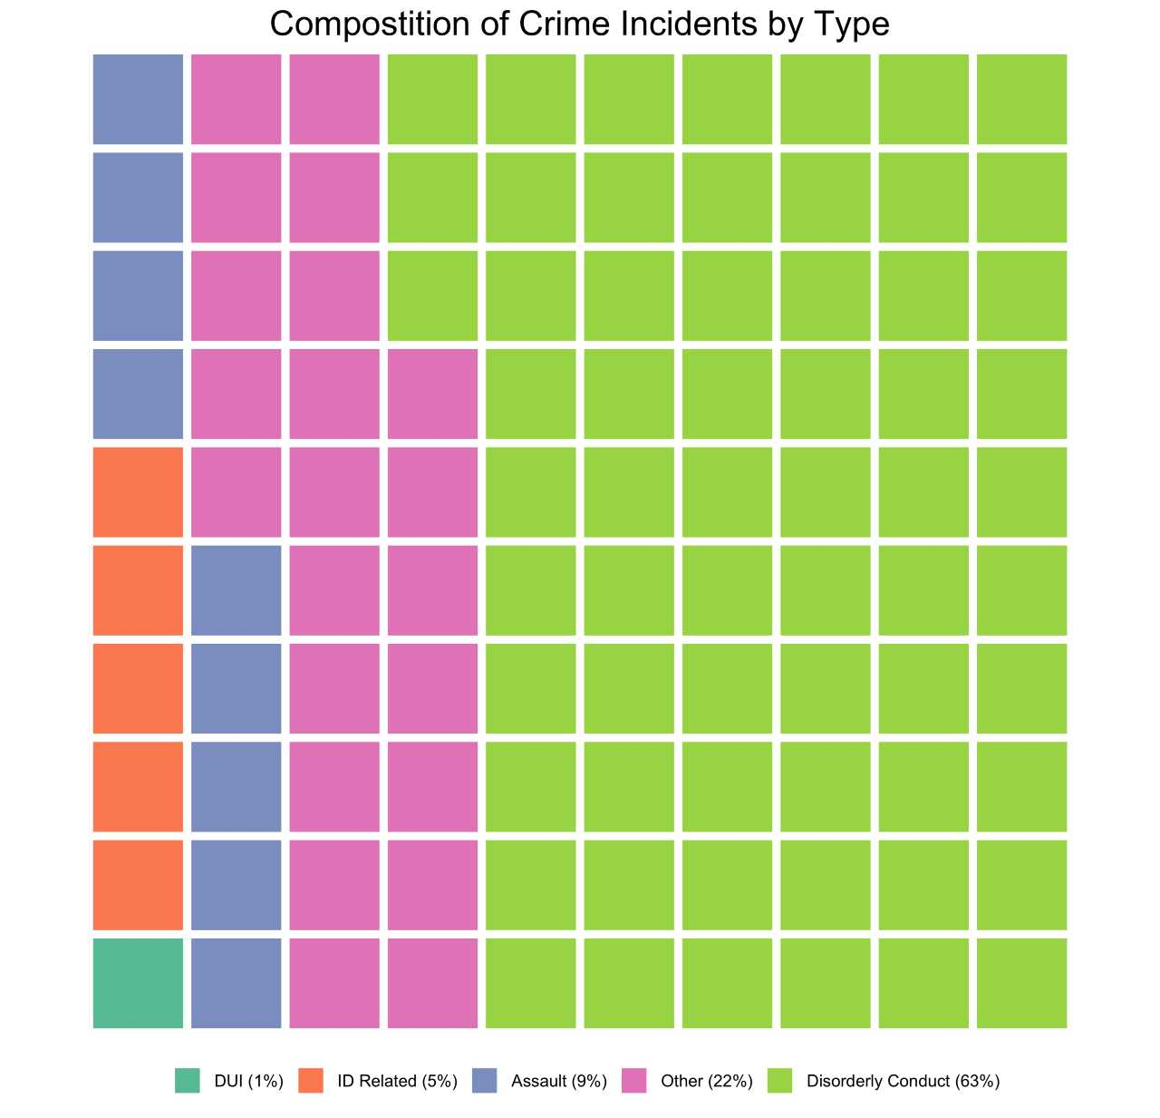
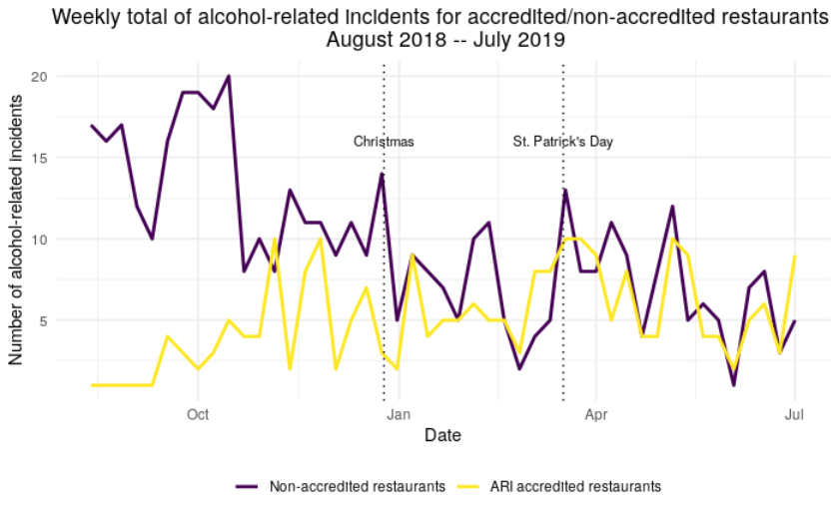
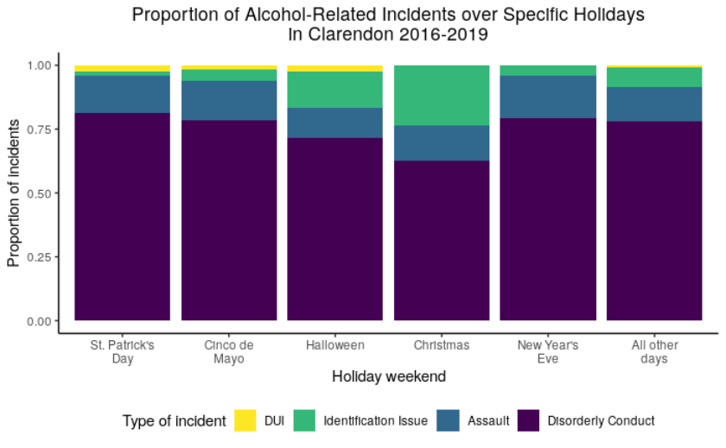
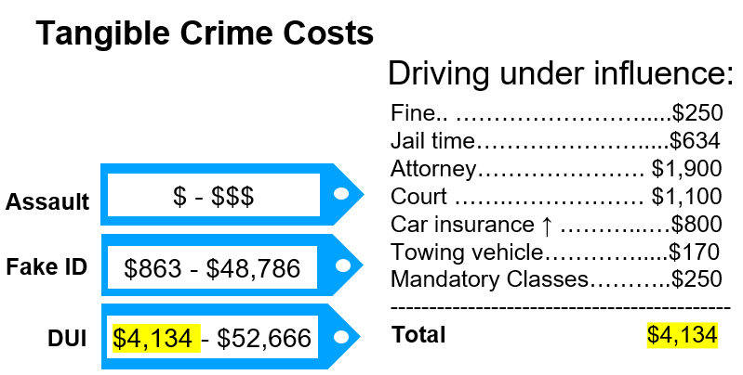

ECONOMIC AND SOCIAL IMPACT OF ARLINGTON RESTAURANT INITIATIVE
DSPG Team: Victoria Halewicz (University of Illinois at Urbana-Champaign), Kateryna Savchyn (Georgetown University),
Jessica Keast (Smith College)
SDAD Team: José Bayoán Santiago Calderón, Gizem Korkmaz, and Aaron Schroeder Sponsor: Dimitrios Mastoras, Arlington County Police Department
Introduction
Data Sources
The Arlington Restaurant Initiative trains and certifies restaurants and bars to prevent and proactively address nightlife alcohol-related incidents.
Is the intervention reducing alcohol-related crime?
How do we quantify the economic impact of the program?
Arlington County Police Department (ACPD)
-Police Incident Logs
-Nightlife Detail Calls for Service
-Restaurant Accreditation information
Virginia Alcoholic Beverage Control (ABC)
-Licenses and Violations
Yelp Restaurant Features
GEOSPATIAL CRIMES APPLICATION
SIMILARITY MATRIX
Spatially explore crimes in Arlington County from 2016 – present
Visualize data by year, by crime type, and area of interest
View establishments and ABC violations for restaurants included in the analysis
Explore incident occurrence by the hour
Export raw data including descriptions and time stamps of incidents
Develop similarity scores among 89 restaurants based on Yelp 51 attribute features (e.g., “Kid Friendly”, “Noise Level”)
Jaccard Similarity Indexing is computed as the intersection of shared features over the union of features between all restaurant combinations
The similarity matrix is used to identify similar restaurants for various statistical models
http://acpd.policy-analytics.net/
Data Exploration
CRIME DISTRIBUTION
SEASONAL TRENDS
General downward trend of crime across both accredited and non-accredited restaurants. Peak holidays include Christmas and St. Patrick’s Day.
Crime type prevalence differs by holiday. Christmas has the least disorderly but greatest identification crimes. Halloween has the most DUIs.
COSTS OF CRIMES
RESTAURANT SPECIFIC CRIME COUNTS AND FLUCTUATION
Preliminary crime costs calculated using tangible prices (see example).
We used cost estimates from various studies and the number of incidents in Arlington to calculate the minimum and maximum yearly costs for crime types.
Example of a cost estimation (minimum)
Two restaurants in the accreditation program comprise the majority of crime incidents in our database.
While most restaurants exhibit a decreasing trend in crimes, one establishment’s crime incidents continues to rise.
Conclusion & Next Steps
Perform a cost and benefit analysis of the program
Develop tangible and intangible estimates & incorporate disorderly conduct crimes
Cost estimates as individual versus government costs to increase accuracy of public savings attributed to the program
Our next steps will include intangible costs of crime such as psychological distress, impaired productivity.

